Slide 1
Chat Application
By :
Ratan J Naik

Slide 2
Agenda
Introduction
Patterns Used
Walk Through Each Pattern
Overall View
Demo

Slide 3
Introduction
The Real-Time Chat Application is a Java-based platform that offers interactive chat capabilities, integrating the Singleton and Observer patterns for efficient chat room management and user notifications. Additionally, it employs the Callback pattern to handle incoming messages reactively and the Delegation pattern to offload message processing, ensuring the system's high adaptability and ease of maintenance.

Slide 4
Pattern Used
Callback (Not taught in class) - To handle events such as receiving new messages.
Delegation (Not taught in class) - To allow an object to delegate operations to another helper object. This is useful for message-handling strategies.
Observer (Taught in class) - To notify participants in a chat room when a new message is posted.
Singleton (Taught in class) - To ensure that there is a single instance of a class responsible for managing chat rooms.

Slide 5
Walk Through Each Pattern
Explaining its purpose and how it is used

Slide 6
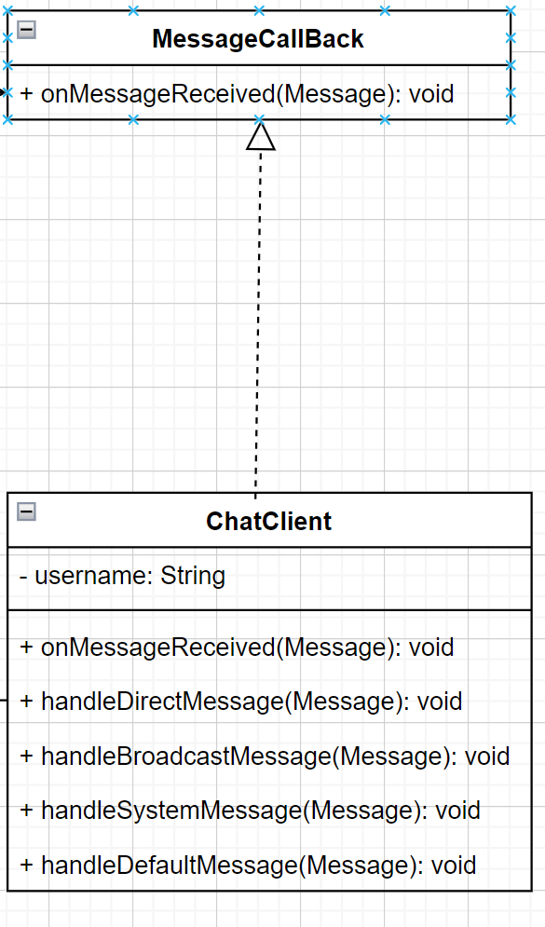
Callback Pattern
This pattern is generally used to provide a mechanism for notifying calling objects when a particular task (such as receiving a message) is completed. In the context of the chat application, it allows the system to execute specific functions in response to events, enhancing the interactivity of the chat experience.

Slide 7
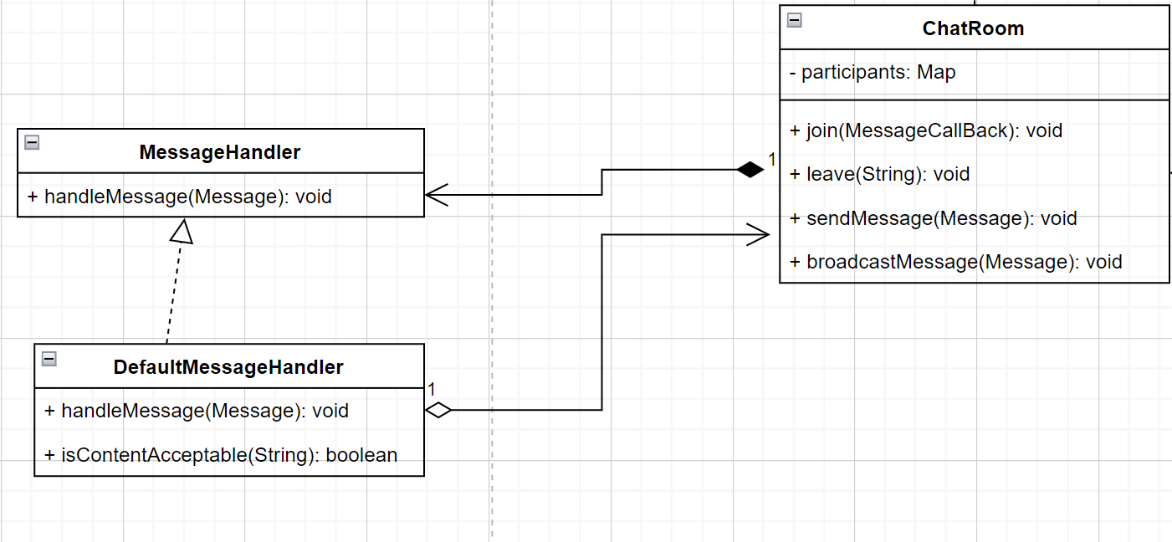
Delegation Pattern
The purpose of the delegation pattern is to pass on the task of handling a particular operation to another class or method. In the chat application, this pattern can be used to delegate the task of processing messages to different handlers, depending on the message type or content, which simplifies the main message processing logic and makes it more manageable.

Slide 8
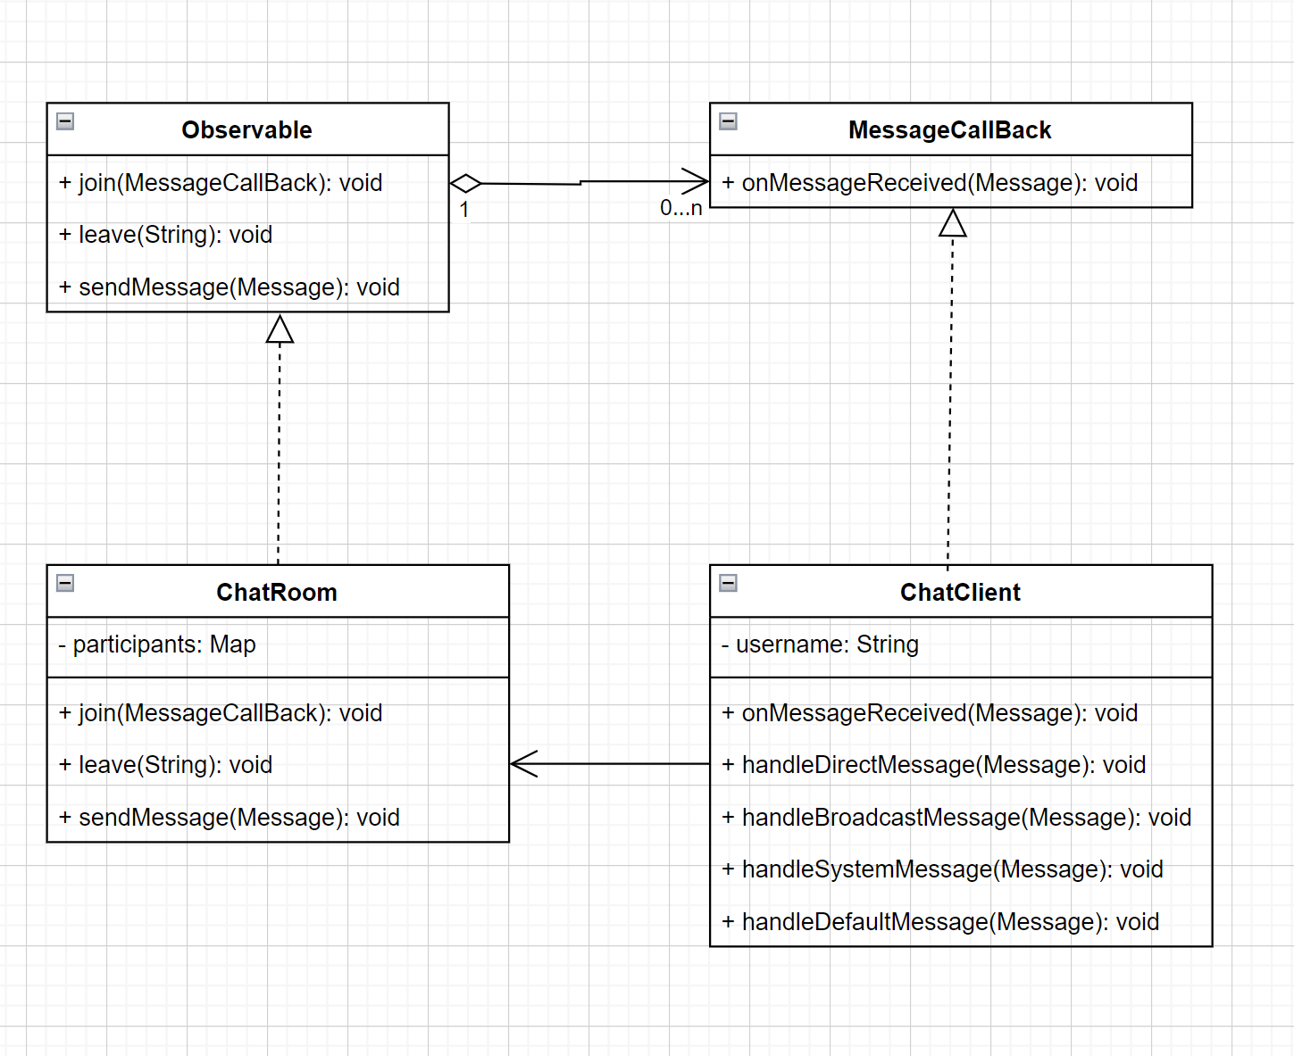
Observer Pattern
This pattern is crucial for real-time updates within chat rooms. It allows users to "subscribe" to a chat room and receive updates whenever a new message is posted. The chat room acts as the "subject," while the users are "observers" who are notified of changes, fostering a responsive user interface.

Slide 9
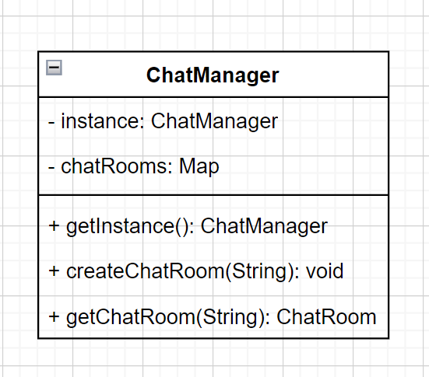
Singleton Pattern
Used to ensure that there is only one instance of the ChatManager class throughout the application. It controls chat room creation and management, providing a global access point and preventing the inconsistencies that multiple instances could cause.

Slide 10
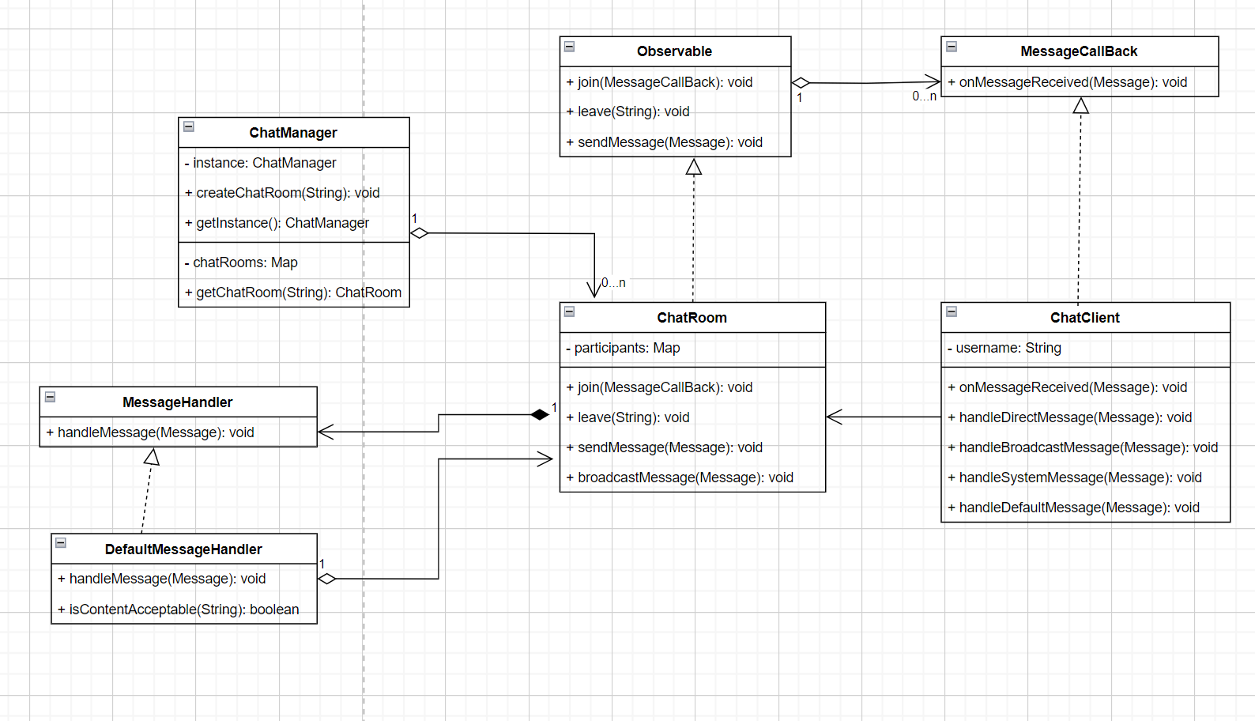

Slide 11
Thank you

